Slide 1

Lecture 2 Epidemic theory 1: typical epidemic dynamics and the susceptible-infectious-removed (SIR) model
Lecturer: Oliver Eales

Slide 2
Typical epidemic dynamics

Slide 3
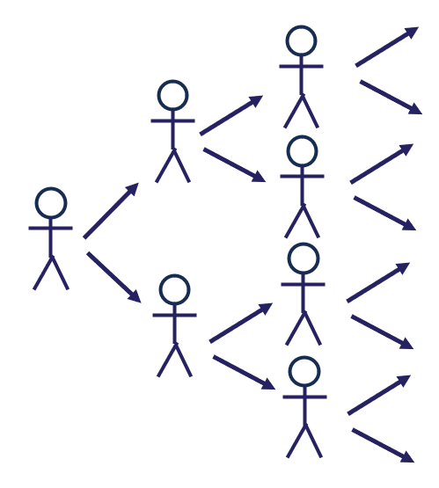
Branching processes
Fundamentally, epidemic dynamics are the result of many individual transmission events
An infected individual may infect other individuals
These may then go on to infect other individuals
This is known as a branching process

Slide 4
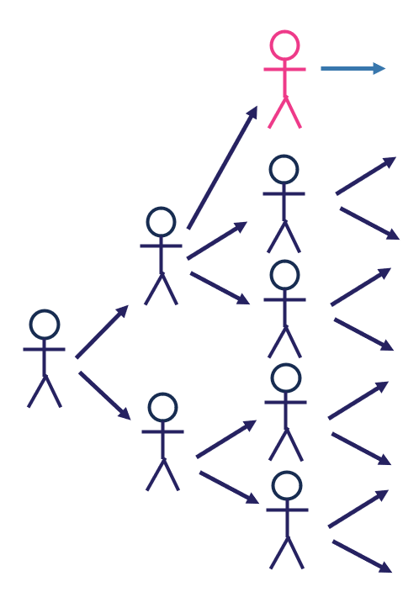
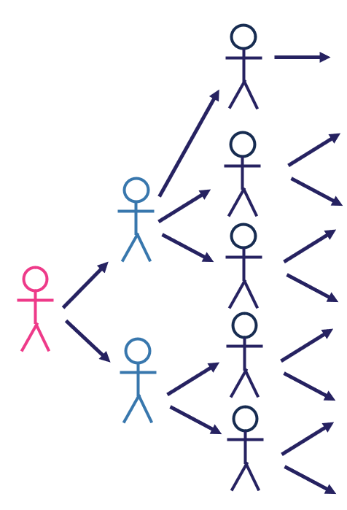
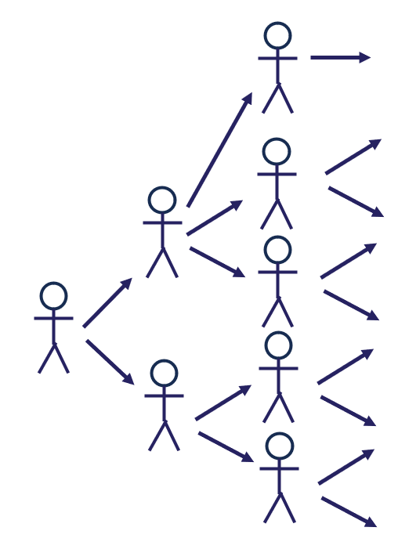
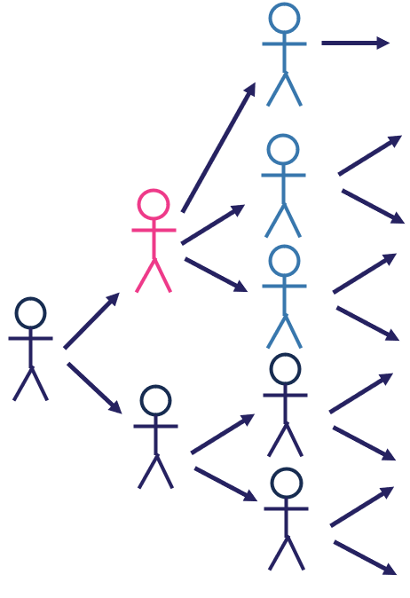
The expected number of infections
The number of infections caused by an infected individual can vary between individuals
How many secondary infections will a primary infection cause?
What factors will contribute?
Primary
infection
Secondary
infections

Slide 5
Group discussion
How many secondary infections will a primary infection cause?
What factors will contribute?

Slide 6

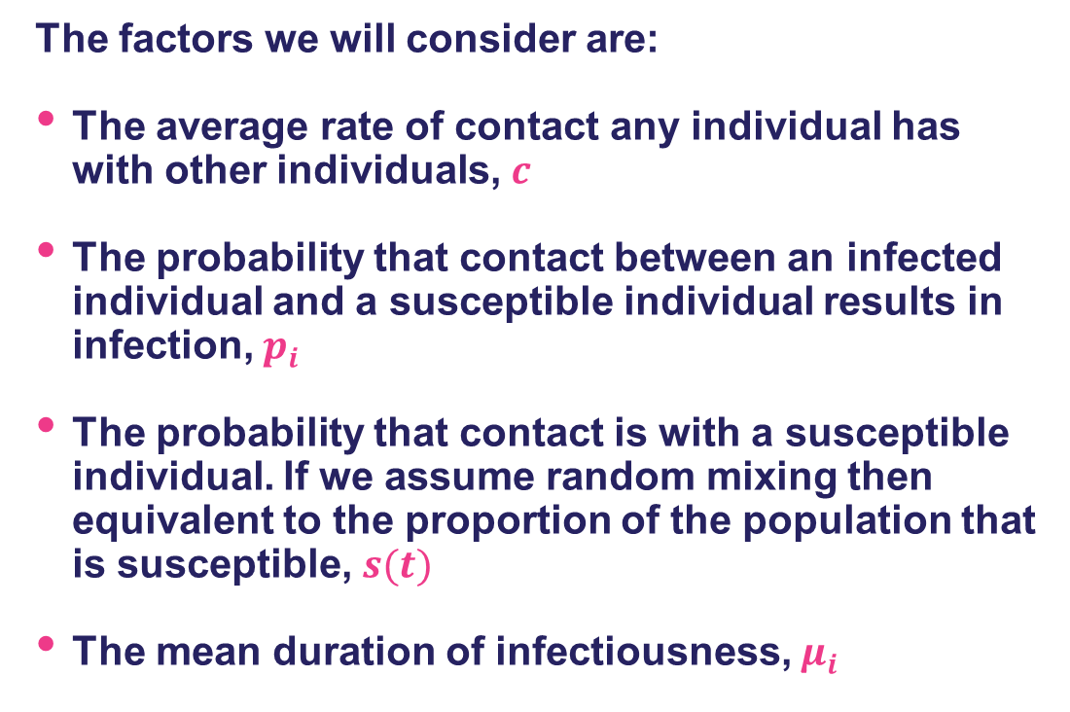
The expected number of infections
The factors we will consider are:
The average rate of contact any individual has with other individuals, $c$
The probability that contact between an infected individual and a susceptible individual results in infection, $p_{i}$
The probability that contact is with a susceptible individual. If we assume random mixing then equivalent to the proportion of the population that is susceptible, $s(t)$
The mean duration of infectiousness, $μ_{i}$
The expected number of secondary infections is then:
$$c×p_{i}×μ_{i}×s(t)$$

Slide 7
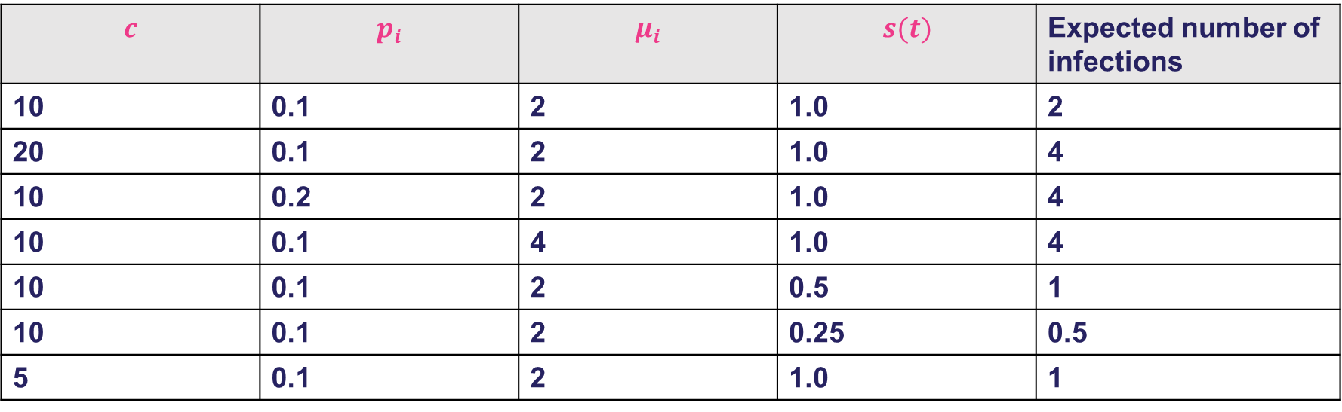
The expected number of infections
$$c$$ | $$p_{i}$$ | $$μ_{i}$$ | $$s(t)$$ | Expected number of infections
10 | 0.1 | 2 | 1.0 | 2
20 | 0.1 | 2 | 1.0 | 4
10 | 0.2 | 2 | 1.0 | 4
10 | 0.1 | 4 | 1.0 | 4
10 | 0.1 | 2 | 0.5 | 1
10 | 0.1 | 2 | 0.25 | 0.5
5 | 0.1 | 2 | 1.0 | 1
What will happen if the expected number of infections is less than one?
The expected number of secondary infections is then:
$$c×p_{i}×μ_{i}×s(t)$$

Slide 8
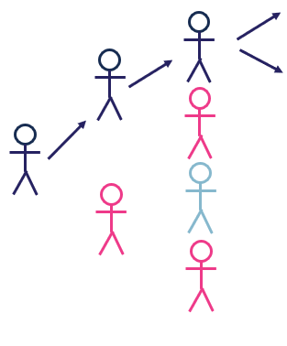

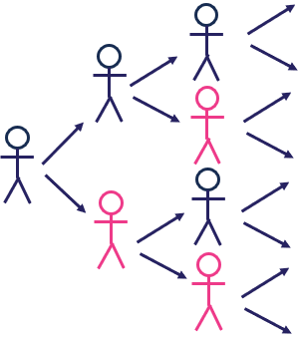
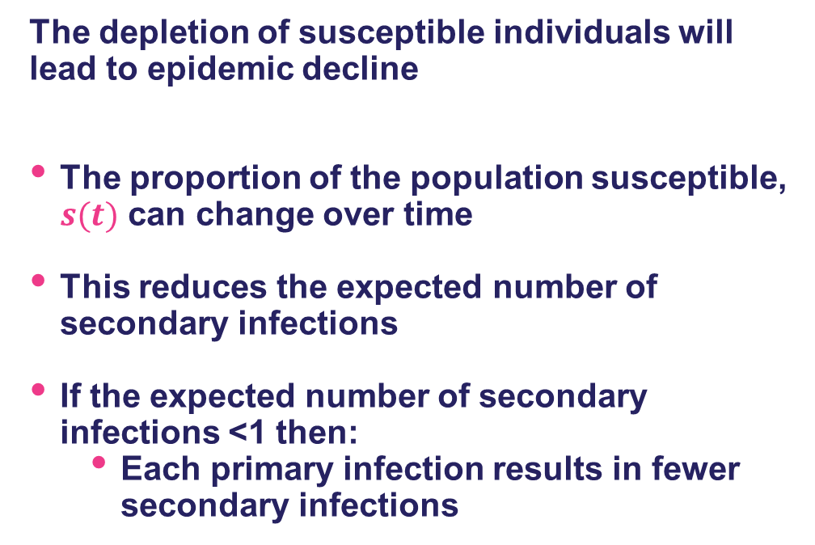

Depletion of susceptibles
The depletion of susceptible individuals will lead to epidemic decline
The proportion of the population susceptible, $s(t)$ can change over time
This reduces the expected number of secondary infections
If the expected number of secondary infections <1 then:
Each primary infection results in fewer secondary infections
Infections
Immune
Not infected
The expected number of secondary infections is then:
$$c×p_{i}×μ_{i}×s(t)$$
8

Slide 9

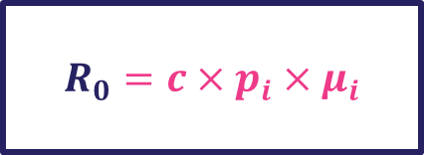
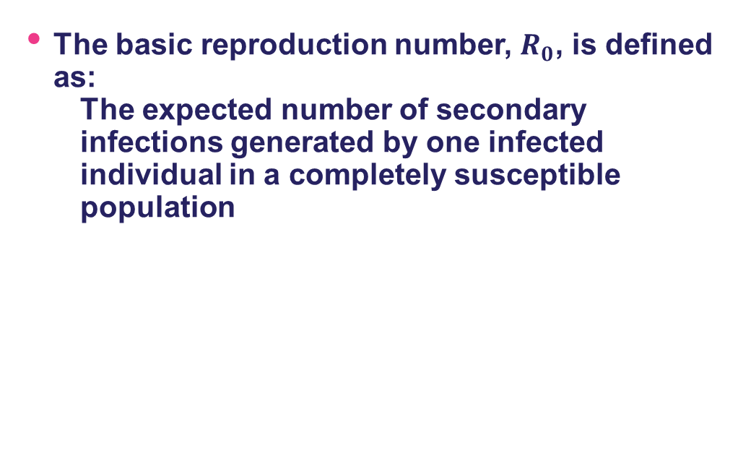

Key term: the basic reproduction number, $R_{0}$
The basic reproduction number, $R_{0}$, is defined as:
The expected number of secondary infections generated by one infected individual in a completely susceptible population
$$R_{0}=c×p_{i}×μ_{i}$$
The expected number of secondary infections is then:
$$c×p_{i}×μ_{i}×s(t)$$

Slide 10
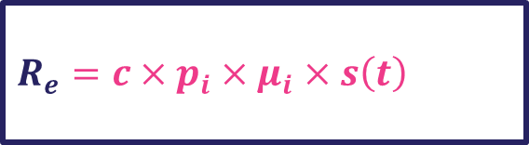
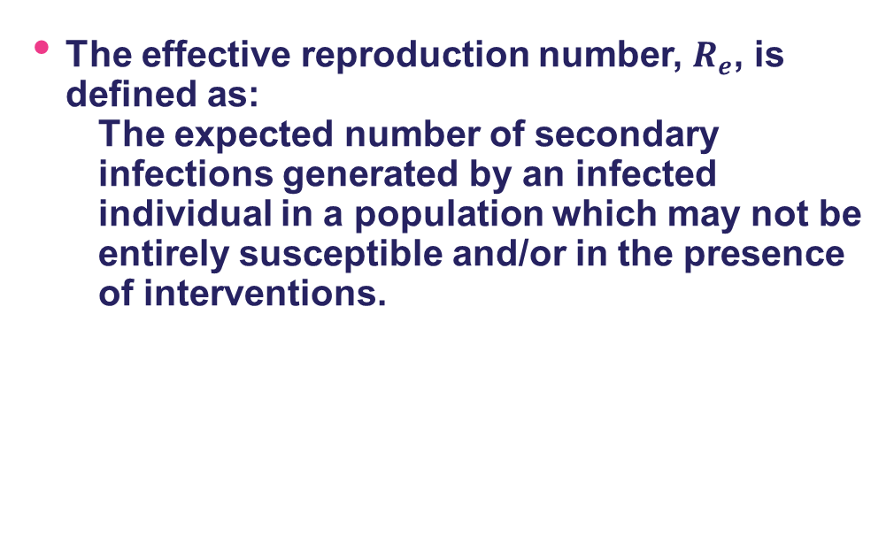

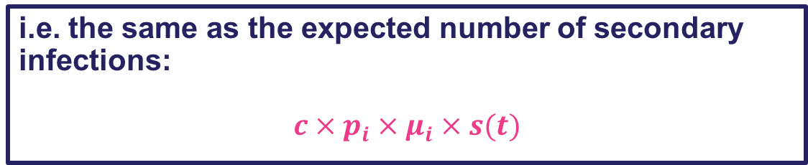
Key term: the effective reproduction number, $R_{e}$
The effective reproduction number, $R_{e}$, is defined as:
The expected number of secondary infections generated by an infected individual in a population which may not be entirely susceptible and/or in the presence of interventions.
$R_{e}=c×p_{i}×μ_{i}$ $×s\left(t\right)$
i.e. the same as the expected number of secondary infections:
$$c×p_{i}×μ_{i}×s(t)$$

Slide 11

The expected number of infections
$$c$$ | $$p_{i}$$ | $$μ_{i}$$ | $$s(t)$$ | Expected number of infections
10 | 0.1 | 2 | 1.0 | 2
20 | 0.1 | 2 | 1.0 | 4
10 | 0.2 | 2 | 1.0 | 4
10 | 0.1 | 4 | 1.0 | 4
10 | 0.1 | 2 | 0.5 | 1
10 | 0.1 | 2 | 0.25 | 0.5
5 | 0.2 | 2 | 1 | 1
What is the effective reproduction number in each example?
What is the basic reproduction number in each example?

Slide 12
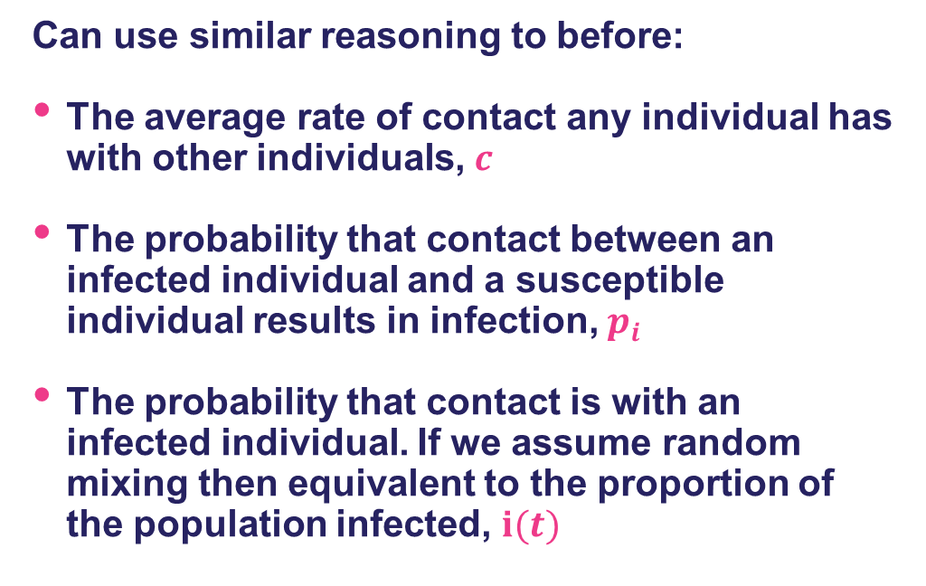

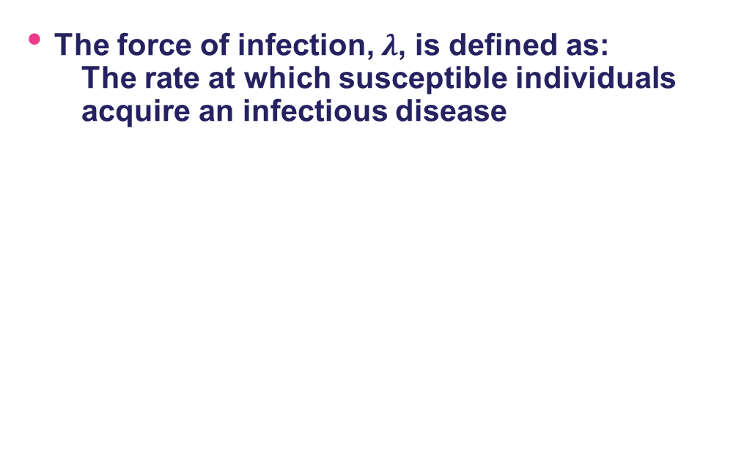
Key term: the force of infection
The force of infection, $λ$, is defined as:
The rate at which susceptible individuals acquire an infectious disease
Can use similar reasoning to before:
The average rate of contact any individual has with other individuals, $c$
The probability that contact between an infected individual and a susceptible individual results in infection, $p_{i}$
The probability that contact is with an infected individual. If we assume random mixing then equivalent to the proportion of the population infected, $i(t)$
The force of infection is then:
$$λ=c×p_{i}×i(t)$$

Slide 13
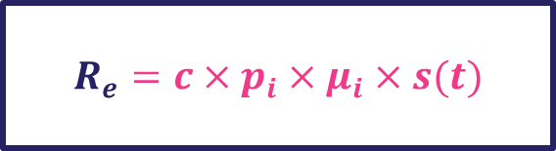
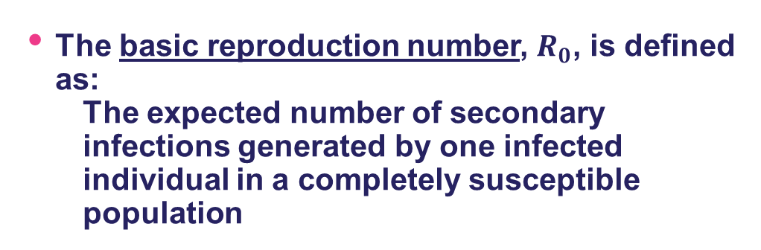
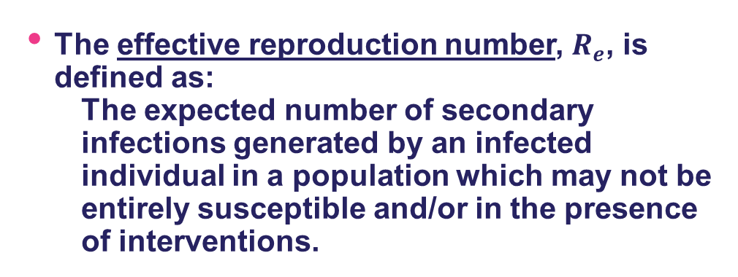
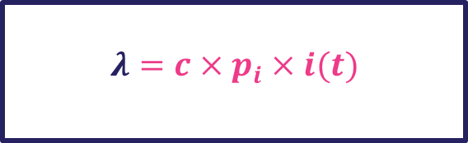
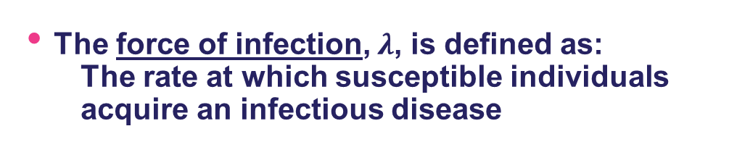

Summary of key terms
The basic reproduction number, $R_{0}$, is defined as:
The expected number of secondary infections generated by one infected individual in a completely susceptible population
$$R_{0}=c×p_{i}×μ_{i}$$
The effective reproduction number, $R_{e}$, is defined as:
The expected number of secondary infections generated by an infected individual in a population which may not be entirely susceptible and/or in the presence of interventions.
$$R_{e}=c×p_{i}×μ_{i}×s(t)$$
The force of infection, $λ$, is defined as:
The rate at which susceptible individuals acquire an infectious disease
$$λ=c×p_{i}×i(t)$$

Slide 14
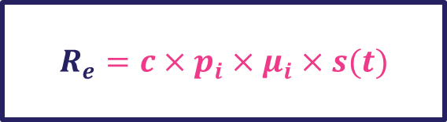
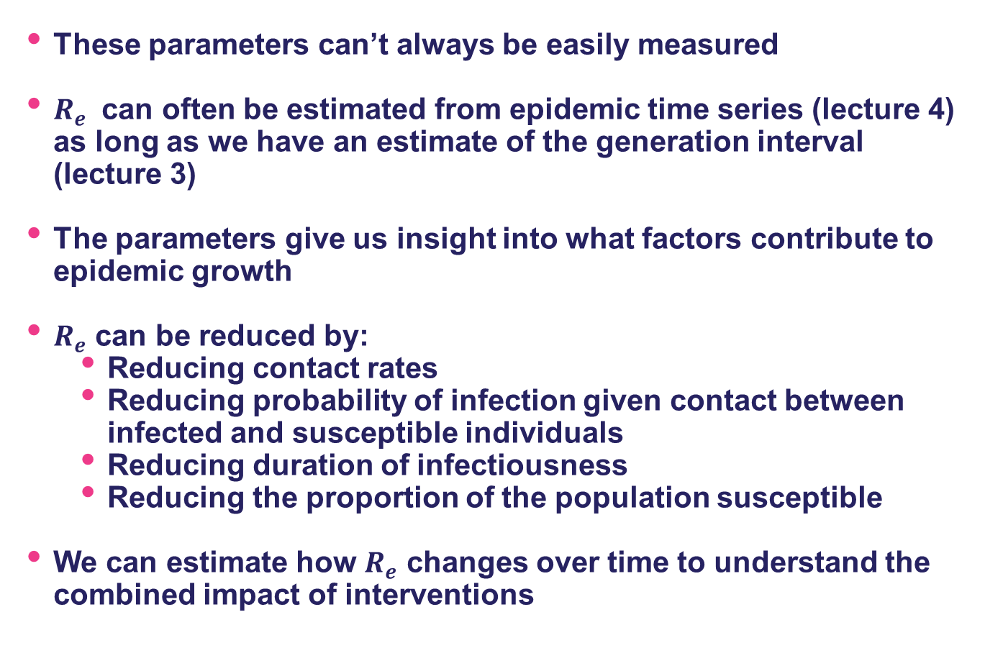
So how do we measure these parameters?
These parameters can’t always be easily measured
$R_{e}$ can often be estimated from epidemic time series (lecture 4) as long as we have an estimate of the generation interval (lecture 3)
The parameters give us insight into what factors contribute to epidemic growth
$R_{e}$ can be reduced by:
Reducing contact rates
Reducing probability of infection given contact between infected and susceptible individuals
Reducing duration of infectiousness
Reducing the proportion of the population susceptible
We can estimate how $R_{e}$ changes over time to understand the combined impact of interventions
$$R_{e}=c×p_{i}×μ_{i}×s(t)$$

Slide 15
Compartmental models

Slide 16
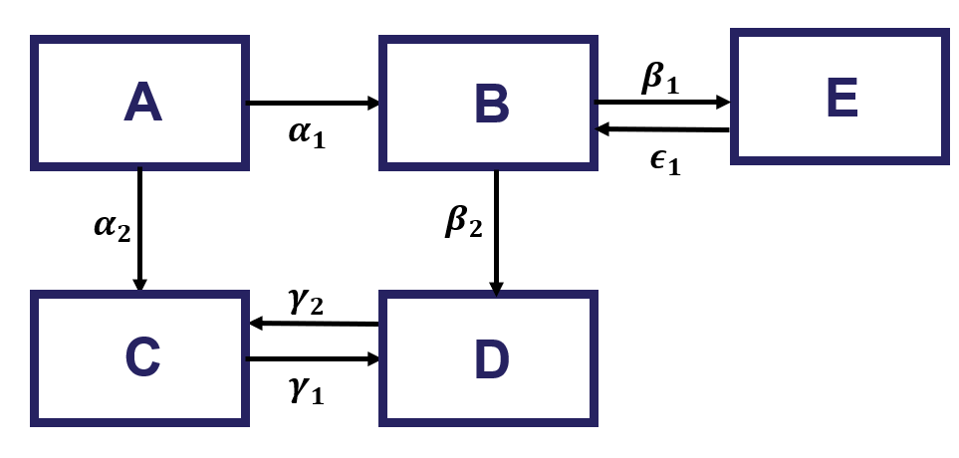
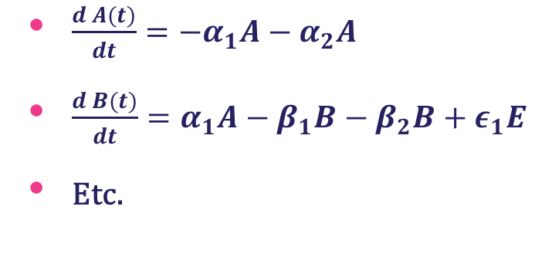
Compartmental models
Compartmental models are a mathematical framework for simulating how populations move between different states or “compartments”
Compartment models for modelling infectious diseases divide the population into compartments based on their epidemiological status.
The movement of the population between compartments is defined by a system of equations which define the rate at which individuals flow between each compartment
$\frac{d A(t)}{dt}=−α_{1}A−α_{2}A$
$\frac{d B(t)}{dt}=α_{1}A−β_{1}B−β_{2}B+ε_{1}E$
Etc.

Slide 17
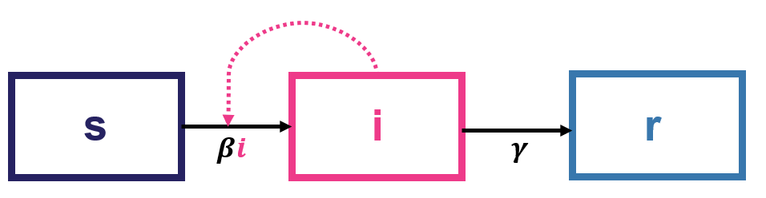
The SIR model
The SIR model is one of the simplest compartmental models of infectious diseases
Each individual is in one of three states:
Susceptible (S)
Infected and infectious (I)
Recovered/removed (R)
We are interested in how the proportions of the population in each of S, I, and R (s, i, r) change over time
Infections
Recovery

Slide 18
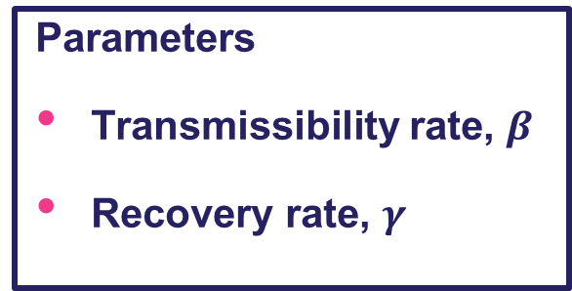
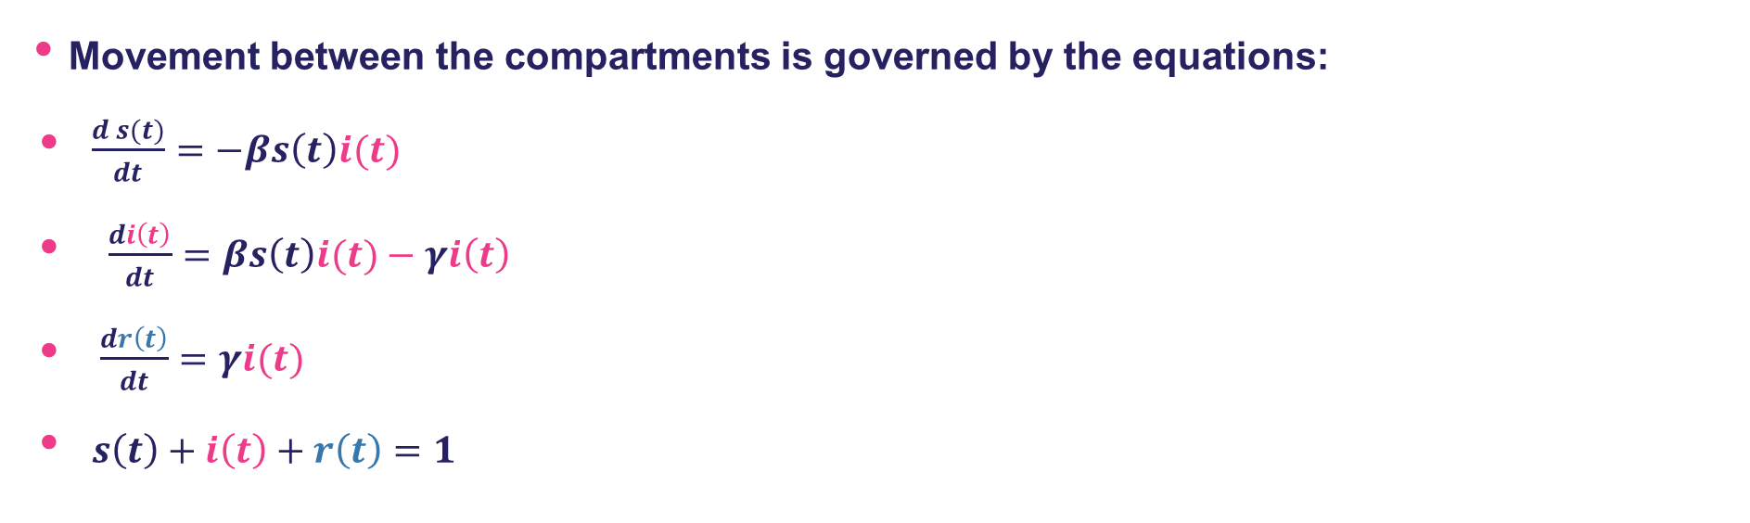
The SIR model
Movement between the compartments is governed by the equations:
$\frac{d s(t)}{dt}=−βs\left(t\right)i(t)$
$\frac{di\left(t\right)}{dt}=βs\left(t\right)i(t)−γi\left(t\right)$
$\frac{dr\left(t\right)}{dt}=γi(t)$
$s\left(t\right)+i\left(t\right)+r\left(t\right)=1$
Parameters
Transmissibility rate, $β$
Recovery rate, $γ$

Slide 19

Key term: the prevalence and incidence of infection
The prevalence of infection is:
The fraction of the population infected
In the SIR model the prevalence of infection is $i\left(t\right)$
$\frac{d s(t)}{dt}=−βi\left(t\right)s(t)$
$\frac{di\left(t\right)}{dt}=βi(t)s\left(t\right)−γi\left(t\right)$
$\frac{dr\left(t\right)}{dt}=γi(t)$
The incidence of infection is:
The rate at which new infections occur over a specific time period
In the SIR model the incidence of infection is $β×i\left(t\right)×s(t)$

Slide 20
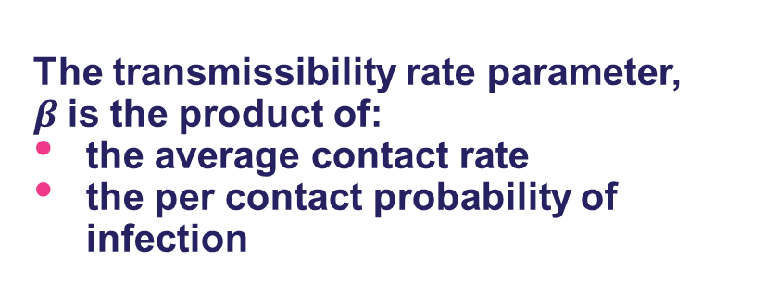
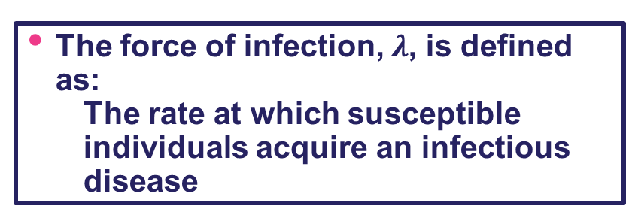
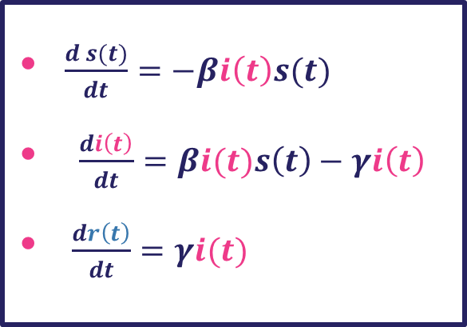

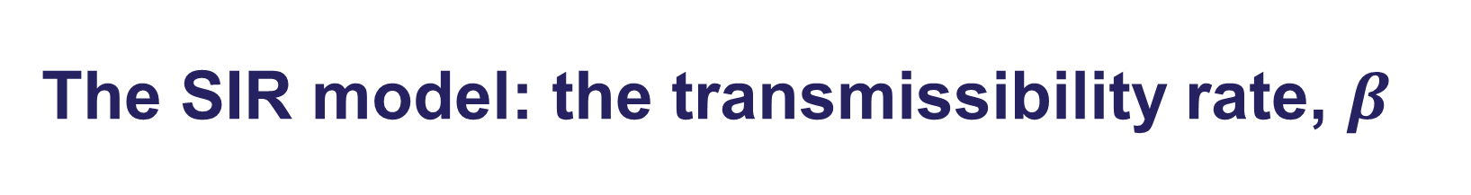

The SIR model: the transmissibility rate, $β$
The force of infection, $λ$, is defined as:
The rate at which susceptible individuals acquire an infectious disease
The force of infection is then:
$$λ=c×p_{i}×i(t)$$
$\frac{d s(t)}{dt}=−βi\left(t\right)s(t)$
$\frac{di\left(t\right)}{dt}=βi(t)s\left(t\right)−γi\left(t\right)$
$\frac{dr\left(t\right)}{dt}=γi(t)$
$$β=c×p_{i}$$
The transmissibility rate parameter, $β$is the product of:
the average contact rate
the per contact probability of infection

Slide 21
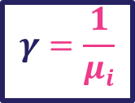
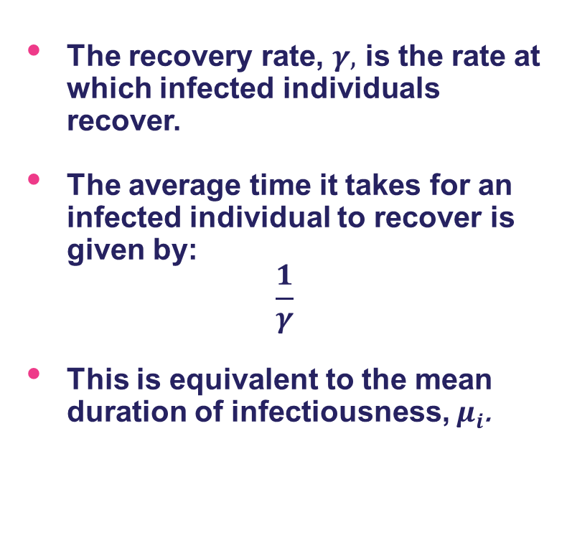

The SIR model: the recovery rate, $γ$
The recovery rate, $γ,$ is the rate at which infected individuals recover.
The average time it takes for an infected individual to recover is given by:
$$\frac{1}{γ}$$
This is equivalent to the mean duration of infectiousness, $μ_{i}$.
$\frac{d s(t)}{dt}=−βi\left(t\right)s(t)$
$\frac{di\left(t\right)}{dt}=βi(t)s\left(t\right)−γi\left(t\right)$
$\frac{dr\left(t\right)}{dt}=γi(t)$
$$γ=\frac{1}{μ_{i}}$$

Slide 22
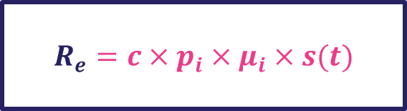
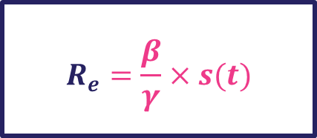

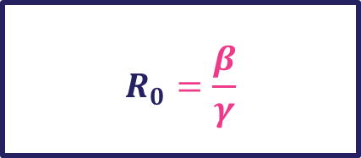


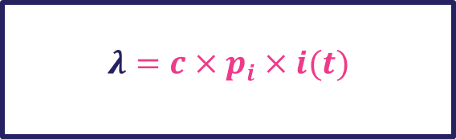


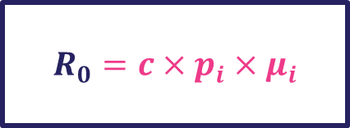

Key terms
$$γ=\frac{1}{μ_{i}}$$
$$β=c×p_{i}$$
The basic reproduction number, $R_{0}$:
$$R_{0}=\frac{β}{γ}$$
$$R_{0}=c×p_{i}×μ_{i}$$
The effective reproduction number, $R_{e}:$
$$R_{e}=c×p_{i}×μ_{i}×s(t)$$
$$R_{e}=\frac{β}{γ}×s(t)$$
The force of infection, $λ$:
$$λ=c×p_{i}×i(t)$$
$$λ=β×i(t)$$

Slide 23
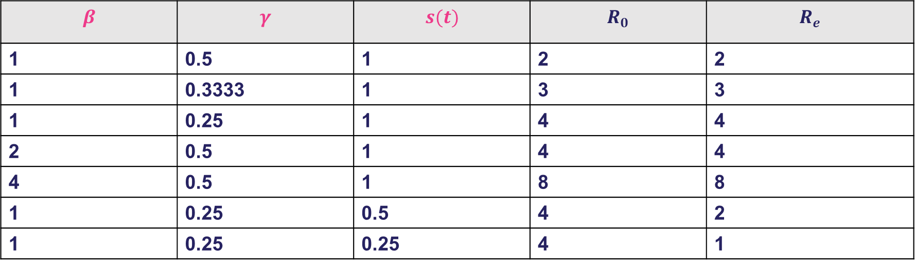


The SIR model: reproduction numbers
$$β$$ | $$γ$$ | $$s(t)$$ | $$R_{0}$$ | $$R_{e}$$
1 | 0.5 | 1 | 2 | 2
1 | 0.3333 | 1 | 3 | 3
1 | 0.25 | 1 | 4 | 4
2 | 0.5 | 1 | 4 | 4
4 | 0.5 | 1 | 8 | 8
1 | 0.25 | 0.5 | 4 | 2
1 | 0.25 | 0.25 | 4 | 1
$$R_{0}=\frac{β}{γ}$$
$$R_{e}=\frac{β}{γ}×s(t)$$

Slide 24
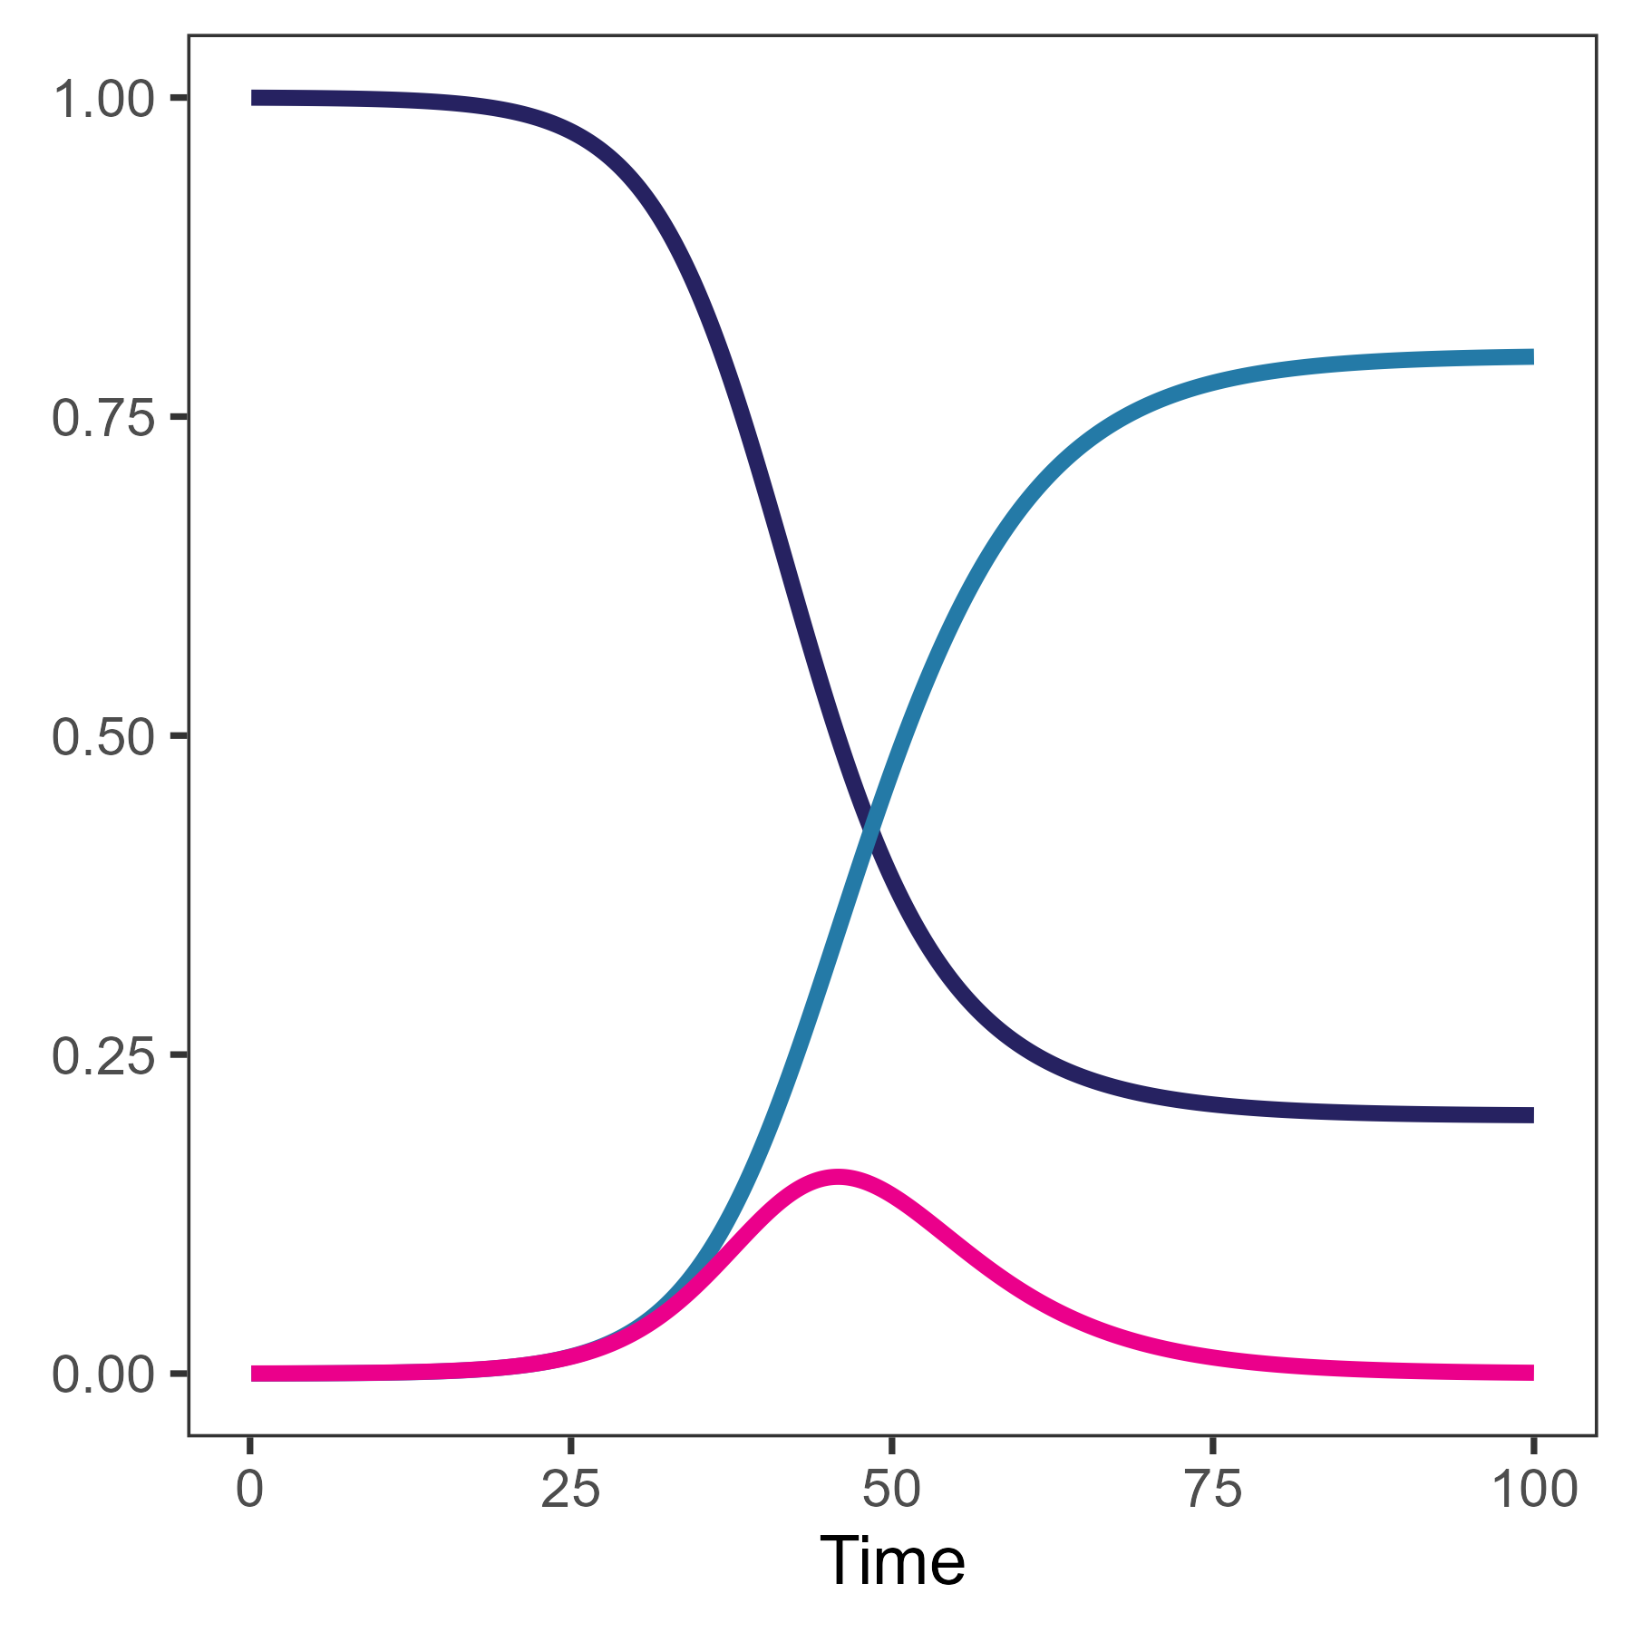

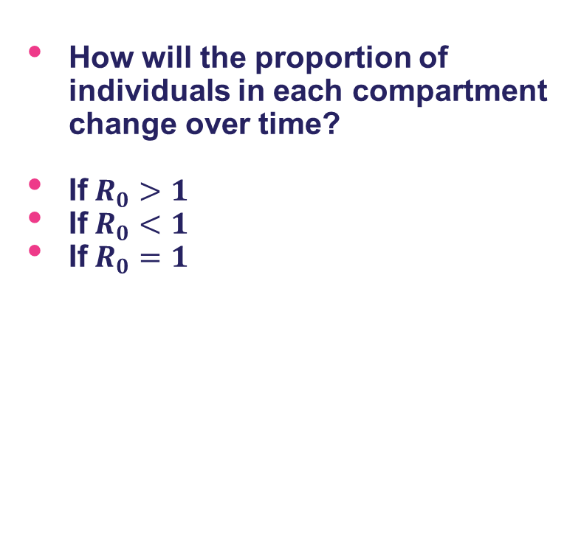

Group discussion
How will the proportion of individuals in each compartment change over time?
If$R_{0}>1$
If$R_{0}<1$
If$R_{0}=1$
$$R_{0}=\frac{β}{γ}$$
$\frac{d s(t)}{dt}=−βi\left(t\right)s(t)$
$\frac{di\left(t\right)}{dt}=βi(t)s\left(t\right)−γi\left(t\right)$
$\frac{dr\left(t\right)}{dt}=γi(t)$

Slide 25
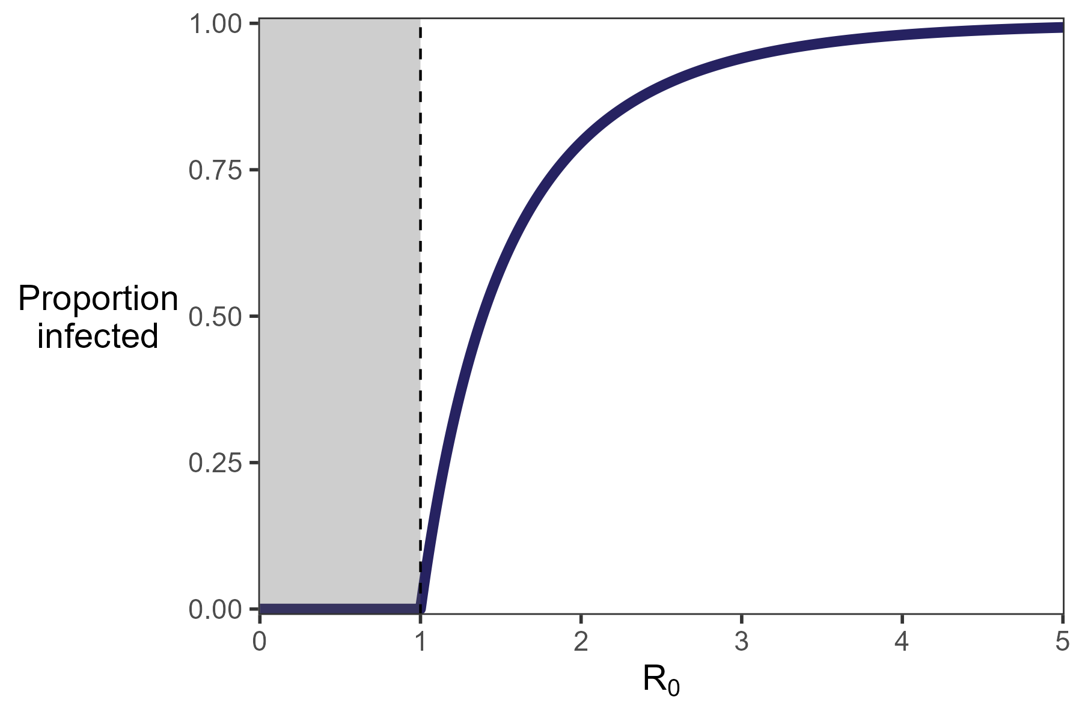

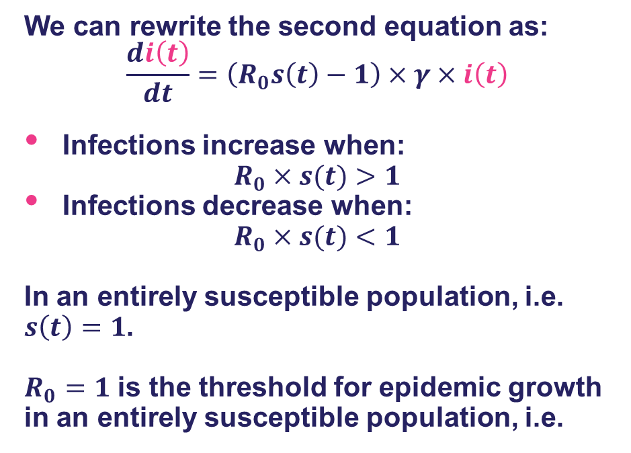

The SIR model: epidemic growth threshold
We can rewrite the second equation as:
$$\frac{di\left(t\right)}{dt}=\left(R_{0}s\left(t\right)−1\right)×γ×i\left(t\right)$$
Infections increase when:
$$R_{0}×s(t)>1$$
Infections decrease when:
$$R_{0}×s(t)<1$$
In an entirely susceptible population, i.e. $s\left(t\right)=1$.
$R_{0}=1$ is the threshold for epidemic growth in an entirely susceptible population, i.e.
$$R_{0}=\frac{β}{γ}$$
$\frac{d s(t)}{dt}=−βi\left(t\right)s(t)$
$\frac{di\left(t\right)}{dt}=βi(t)s\left(t\right)−γi\left(t\right)$
$\frac{dr\left(t\right)}{dt}=γi(t)$
An epidemic can only occur if $R_{0}>1$
The larger the value of $R_{0}$ the bigger the epidemic

Slide 26
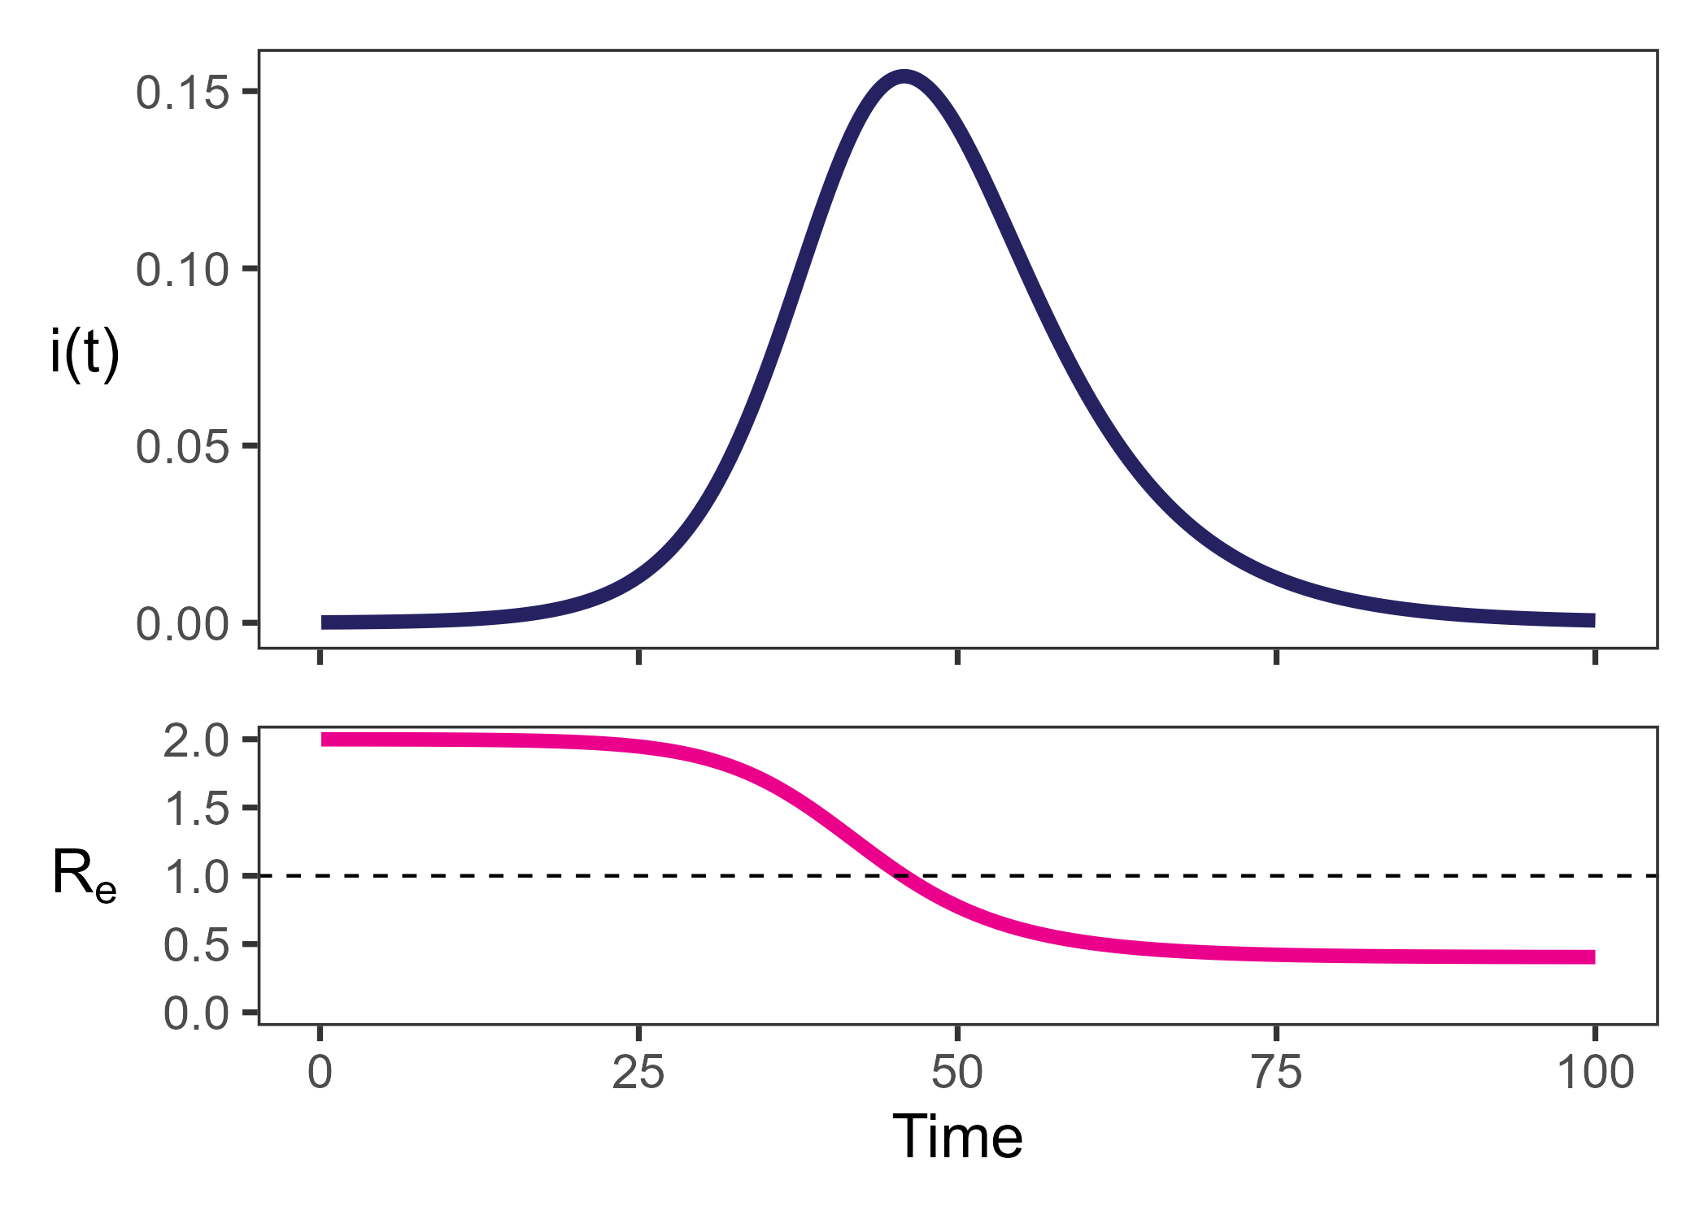
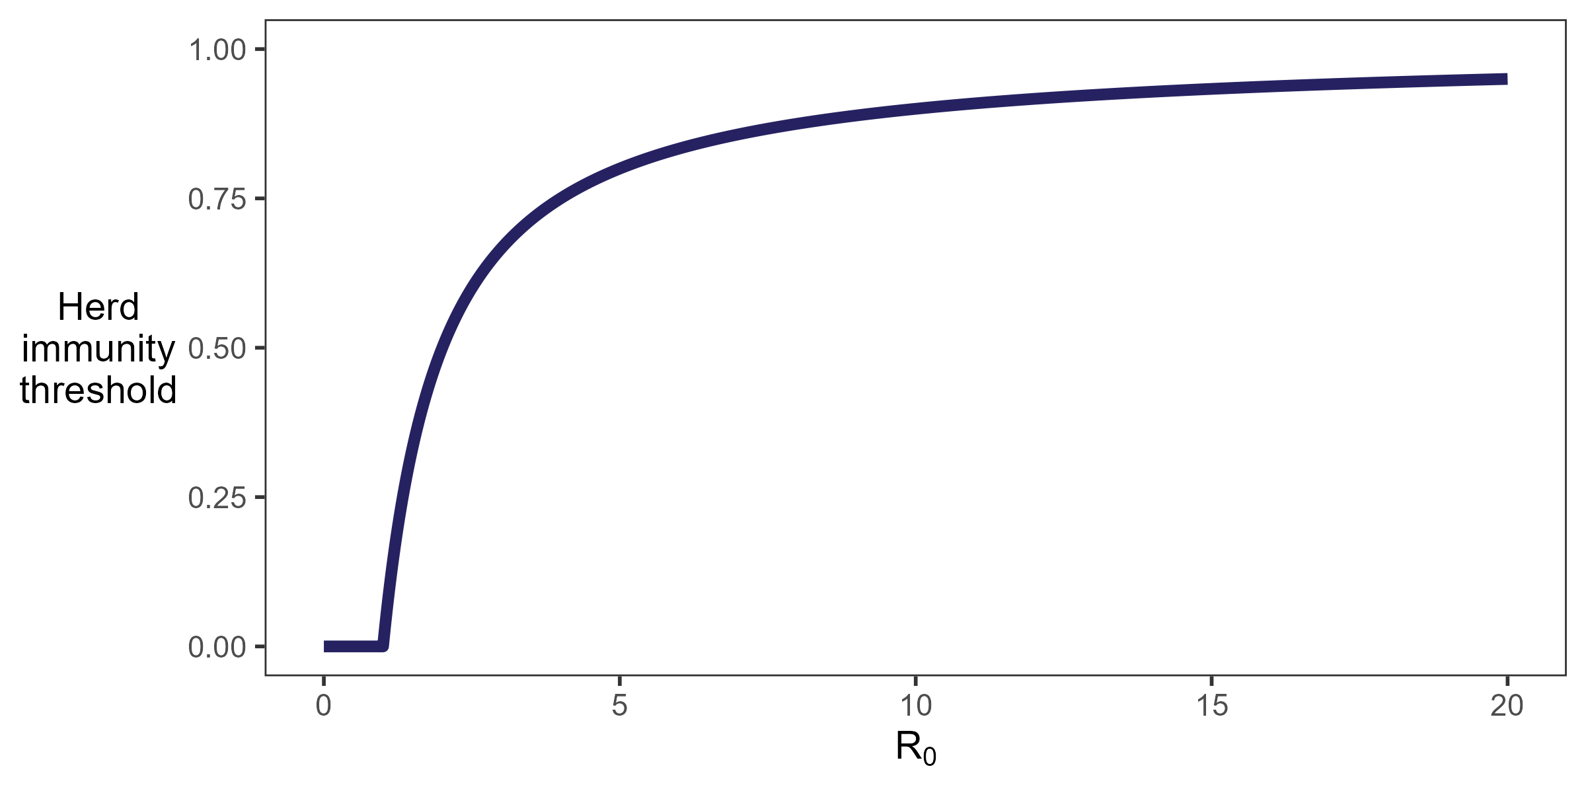

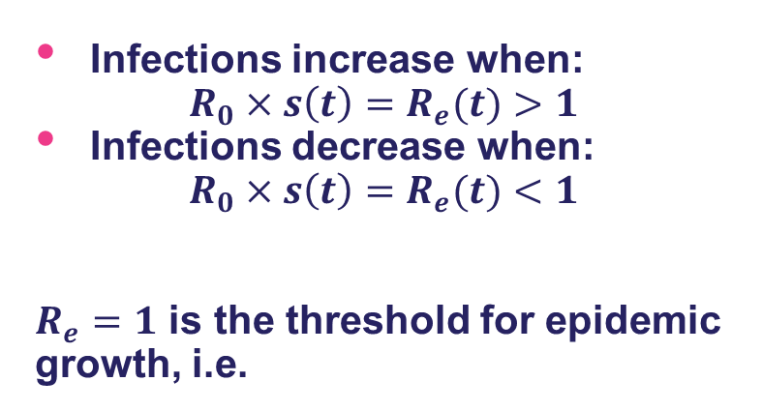

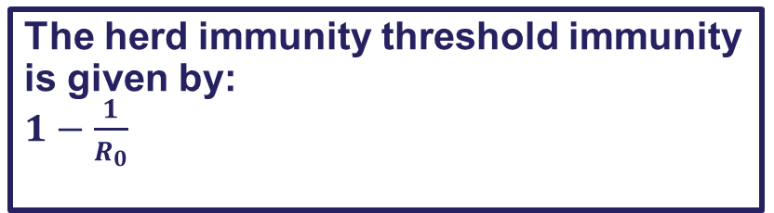
The SIR model: herd immunity threshold
Infections increase when:
$$R_{0}×s\left(t\right)=R_{e}(t)>1$$
Infections decrease when:
$$R_{0}×s\left(t\right)=R_{e}(t)<1$$
$R_{e}=1$ is the threshold for epidemic growth, i.e.
$\frac{d s(t)}{dt}=−βi\left(t\right)s(t)$
$\frac{di\left(t\right)}{dt}=βi(t)s\left(t\right)−γi\left(t\right)$
$\frac{dr\left(t\right)}{dt}=γi(t)$
In a population with some immunity an epidemic can only occur if $R_{e}>1$
When $s\left(t\right)=\frac{1}{R_{0}}$: $R_{e}=1$
The herd immunity threshold immunity is given by:
$1−\frac{1}{R_{0}}$

Slide 27
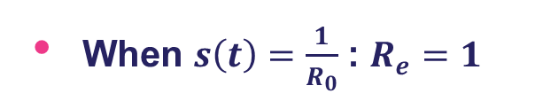



The SIR model: herd immunity threshold
In a population with some immunity an epidemic can only occur if $R_{e}>1$
Pathogen | $$R_{0}$$ | Herd immunity threshold
Influenza | ~2 | 50%
SARS-CoV-2 | ~4 | 75%
Polio | ~7 | 86%
Chickenpox | ~10 | 90%
Measles (lower) | ~15 | 93%
Measles (upper) | ~20 | 95%
When $s\left(t\right)=\frac{1}{R_{0}}$: $R_{e}=1$
The herd immunity threshold immunity is given by:
$1−\frac{1}{R_{0}}$

Slide 28


Group discussion
The SIR model is one of the simplest models of infectious disease dynamics.
What assumptions does the SIR model make?
What does the SIR model not take into account that might be important for understanding epidemic dynamics?
$\frac{d s(t)}{dt}=−βi\left(t\right)s(t)$
$\frac{di\left(t\right)}{dt}=βi(t)s\left(t\right)−γi\left(t\right)$
$\frac{dr\left(t\right)}{dt}=γi(t)$

Slide 29

Some assumptions of the SIR model
Assumes an individual is infectious as soon as they are infected
Assumes all individuals have the same rate of contact
Assumes all individuals are perfectly mixed
Assumes that the transmissibility rate, $β$, is constant over time
$\frac{d s(t)}{dt}=−βi\left(t\right)s(t)$
$\frac{di\left(t\right)}{dt}=βi(t)s\left(t\right)−γi\left(t\right)$
$\frac{dr\left(t\right)}{dt}=γi(t)$
These will be covered in more detail in later lectures

Slide 30
Models should have an appropriate level of complexity
Models range from simple (e.g. grouping individuals into compartments) or highly complex (e.g. simulating the behaviour of all individuals)
The complexity of a model depends on the specific research question/purpose, existing knowledge of the system, available data, and computational resources
Model complexity is not an indicator of its utility
Often a trade-off between reality (complexity, specificity) and understanding (simplicity, generalisability)
More complex models require more detailed data for parameterization
Model “non-identifiability” – multiple different sets of parameter values can produce the same or very similar outputs.

Slide 31
Simulating compartmental models
Compartmental models can be implemented deterministically or stochastically
Deterministic implementation
There is a predetermined relationship between model inputs and structure and model outputs
Model will return the same output if input parameters are the same
Flow between compartments is set by the rates
Stochastic implementation
Includes inherent randomness in the epidemic dynamics
Model will return different outputs for the same input parameters
Need to run the model many times to capture probability of different outcomes
Transitions of individuals between compartments occur with probabilities (determined by rates)

Slide 32





Simulating compartmental models
Compartmental models can be implemented deterministically or stochastically
Deterministic models are best suited to modelling epidemic dynamics in large populations
Stochastic models are more useful in small populations or when infection numbers are low (when capturing chance events are important)
In today’s practical we will:
Explore the dynamics of the SIR model
Compare stochastic simulations vs a deterministic simulation
Stochastic simulations
Deterministic solution

Slide 33
References
Asakura TR, Jung S-M, Jin S, Hu G, Endo A, Dickens BL. Characterising global risk profiles of Mpox clade Ib importation. J Travel Med. 2024;31: taae136.
Bhatt S, Weiss DJ, Cameron E, Bisanzio D, Mappin B, Dalrymple U, et al. The effect of malaria control on Plasmodium falciparum in Africa between 2000 and 2015. Nature. 2015;526: 207–211.
Davies NG, Klepac P, Liu Y, Prem K, Jit M, CMMID COVID-19 working group, et al. Age-dependent effects in the transmission and control of COVID-19 epidemics. Nat Med. 2020;26: 1205–1211.
Ren X, Li Y, Yang X, Li Z, Cui J, Zhu A, et al. Evidence for pre-symptomatic transmission of coronavirus disease 2019 (COVID-19) in China. Influenza Other Respi Viruses. 2021;15: 19–26.
Clifford S, Quilty BJ, Russell TW, Liu Y, Chan Y-WD, Pearson CAB, et al. Strategies to reduce the risk of SARS-CoV-2 importation from international travellers: modelling estimations for the United Kingdom, July 2020. Euro Surveill. 2021;26: 2001440.
Heesterbeek H, Anderson RM, Andreasen V, Bansal S, De Angelis D, Dye C, et al. Modeling infectious disease dynamics in the complex landscape of global health. Science. 2015;347: aaa4339.
Peixoto HM, Bastos LL, Brito-Sousa JD, Sampaio VS, Daumerie PG, Jambert E, et al. The cost-effectiveness of tafenoquine following screening with STANDARDTM G6PD screening for the treatment of vivax malaria in the Brazilian public health system. Social Science Research Network. 2025. doi:10.2139/ssrn.5151134

